Slide 1
Capstone Project Students’ Early Attrition Modelling for Clearwater State University
By : Lakshmipathi PS

Slide 2
Exploratory Data Analysis
Here, Target variable is ‘RETURNED_2ND_YR’
This is a binary output – with 1’s and 0’s
Imbalanced data set with 79% and 21% split
STUDENT IDENTIFIER is Dropped since it’s a Identification columns and will not contribute to the model

Slide 3
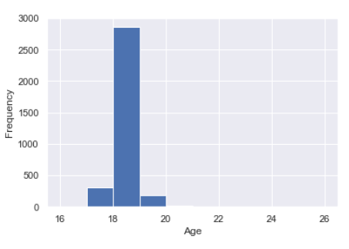
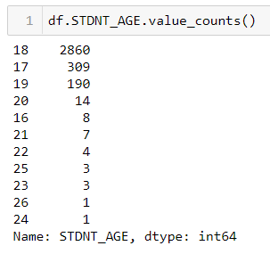
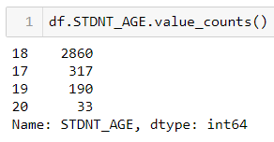
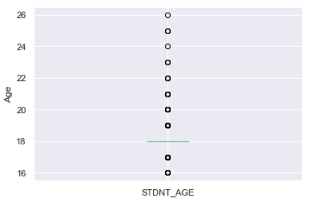
Student Age
Most of the data is found between Age 17 to 20
19 rows having age greater than 20 – Capping Age to 20 and making values above 20 equal to 20
5 rows having age values as 16 – Editing them to be 17
Before
After

Slide 4
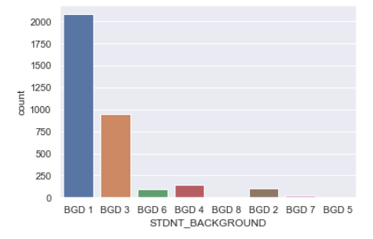
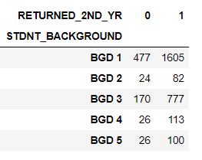
Student Gender and Background
Student Gender ratio is 63% Females and 37% Males
Student Background has no missing values
Merged few Backgrounds as to create as 1 to make Data less sparse
BGD 6 ,7, 8 changed to BGD 5

Slide 5
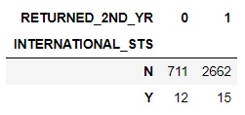
Instate and International Students
Instate Flag variable – Use one hot encoding with Y = 1 and N = 0
International Status – only 27 students out of 3400 are under this category
Column dropped since No much contribution to the Target variable prediction
27 students are almost equally split in Target variable

Slide 6
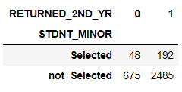
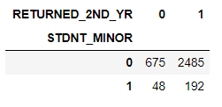
Student Minor
92% of students having N as student minor which might be equal to not opting any course as Minor.
36 subjects available as unique which is consisted of 8%.
Grouping as Minor selected and Not selected for 8% and 92%
Used one hot encoding on this variable since only 2 categories

Slide 7
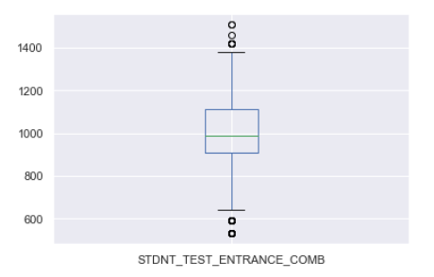
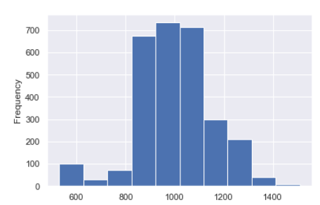
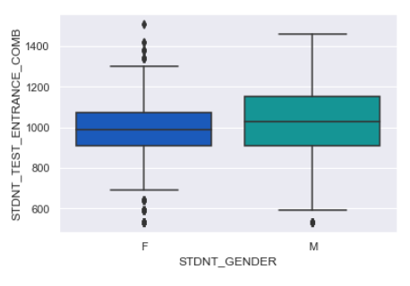
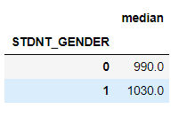
Student Entrance Test
Student Entrance test score Combination has 518 missing values
Respective missing values are imputed with Median imputation based on Gender
This Boxplot gives the difference between male and Female Median values for Student Entrance test combination
Distribution after the Missing values treated and Histogram plotted for the Student Entrance Test combination

Slide 8
Treating Core course variables
There are 6 courses for each semester and all together 12 courses
Based on observation with respect, many subjects duplicated
Ex: ECON 2105 and ECON 2106 -> Both are assumed to be same to decrease the sparsity of the data/ number of categories
Considering only first 4 letters of each course
Ex: ECON 2105 & ECON 2106 -> ECON
Transforming all 12 Core subjects categories to the above stated format
Filling missing values as “not_opted”

Slide 9
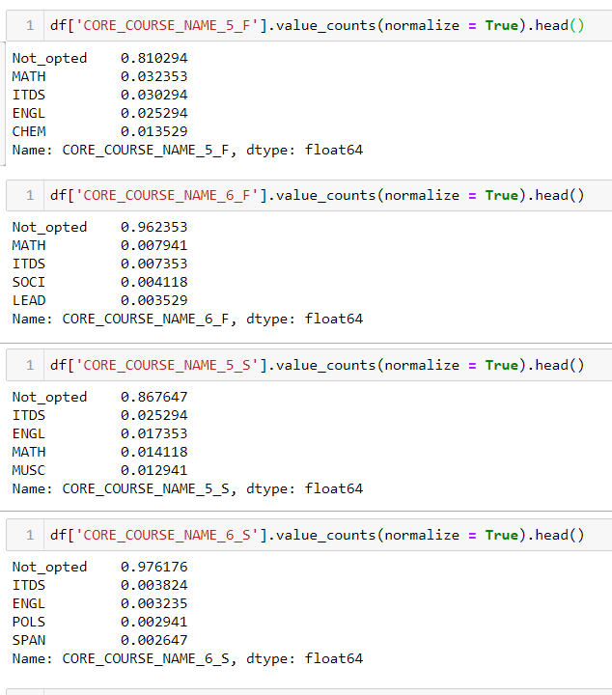
Treating Core course Grade variables
Grades are available as A, B, C, D, F and Incomplete/ Unknown
Using Ordinal categorical variable using Map function for these 12 Grade variables for 12 core subjects.
Null Grades are replaced with value 0
Not_opted or Missing values are 80% and 96% for 5th and 6th Core subject respectively
Since High missing values – These 4 variables with respective to their Grades are ignored from building the model

Slide 10
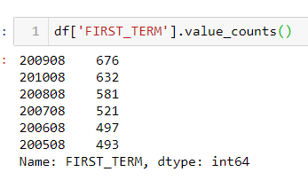
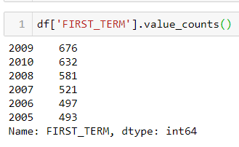
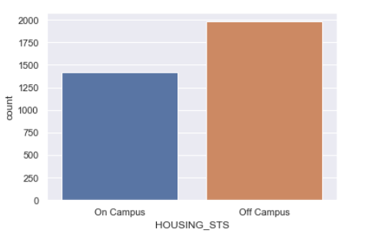
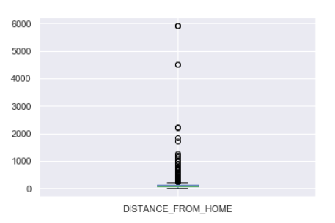
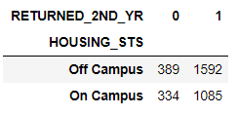
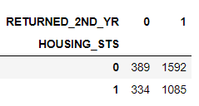
Semester year and Distance From home and Housing status
Values are in Year and month
Values are integer type. Converted to String since Integer value of year makes no contribution
Second Term is First term + 1 year. So This variable is ignored
Housing status are divided into Off Campus and On campus
Values are one hot encoded
Outliers can be seen here in Boxplot for Distance from home
Using Quantile range of 90% for capping the distance of Students
After treating the outliers, Boxplot looks fine and No outliers seems to be residing
Missing values are treated with Median Value Distance from home

Slide 11
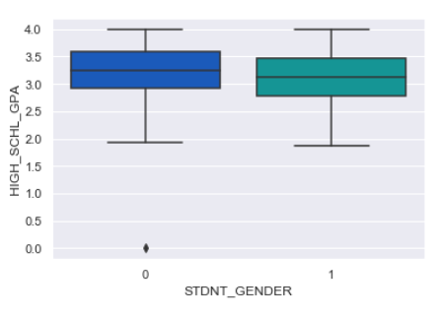
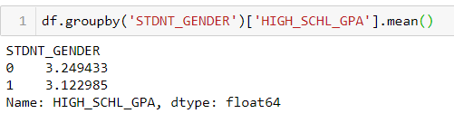
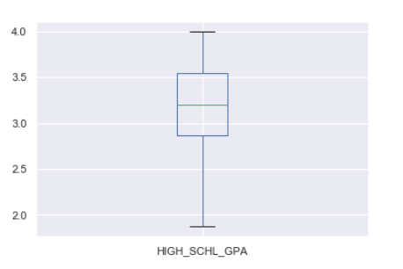
High School GPA
There seems to be only one outlier with value equal to Zero
This value imputed with second lowest value 1.87
There were only 53 values missing in High school GPA
These vales imputed based on the Gender mean values
After treating Missing values and Outliers in the data. Boxplot shows none as outliers

Slide 12
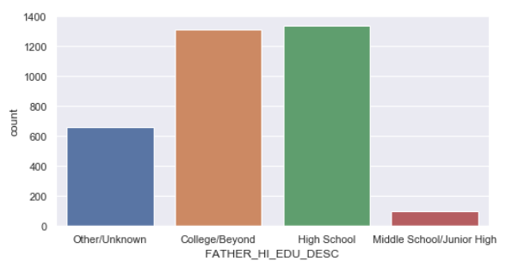
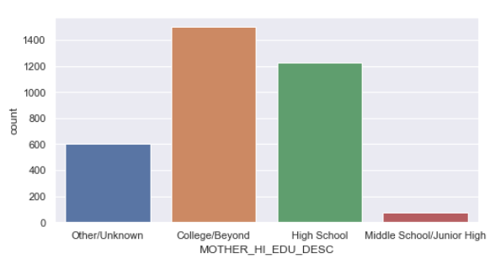
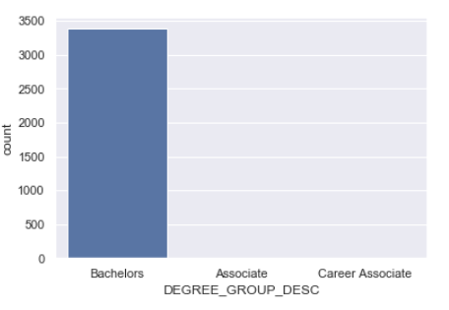
High School, Parents Education, Degree Group
High school does not seems to be contributing any for Predicting Target variable. So ignoring that category
Parent Education – Used as Ordinal variable by recoding as numbers
No Information and Other/Unknown are merged into one category
College = 4, high school = 3, middle school = 2, Unknowns = 1
Most of the values are Bachelors (99.5% of Data)
Way too less other categories wont be contributing to Target variables, So dropping these Columns
First Sem Performance = First term Earned Hours / First term Attempted Hours
Second Sem Performance = Second term Earned Hours / Second term Attempted Hours

Slide 13
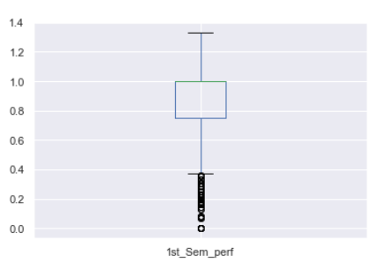
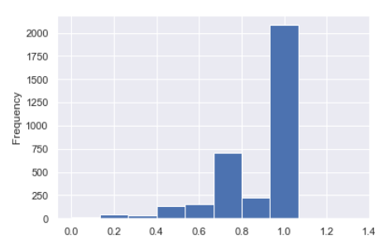
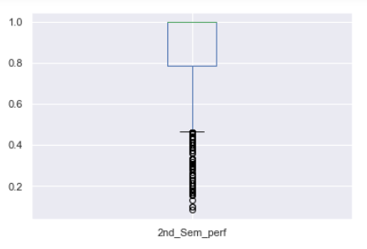
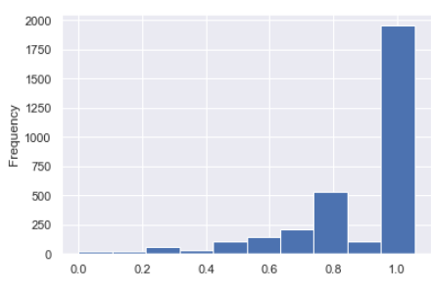
Performance and Financial Terms
Outlier which has extreme value more than 1 are capped at 1
Missing values were present in the 2nd year performance are treated with value zero since many were having 0 as Target value
Gross Financial need + Estimated Family Contribution = Cost of Attend
Gross Financial need in absence of Fam Contribution is same as Cost of attend and hence has very High Correaltion.
Gross financial need not contributing to anything as its essence already followed in Cost of attend, That variable is no considered for Model Building

Slide 14
Model Preparation
Data Target variable has 79% (2677) and 21% (723) data split.
Test train split is imported from Sklearn Model selection module
Data split into Test and train with 80% for testing and 20% for training with Random state as 42
Random Forest for Variable Importance
From Sklearn ensemble importing Random Forest classifier
Model build to obtain the important variables from Random Forest classifier
Top 10 features based on importance are selected and Logistic regression model is built on those features
Random forest is used for Feature importance

Slide 15

Building Model using SKlearn
With Top 10 features selected from the Random Forest, Logistic regression model is built
The Model has an accuracy of 85.29% and ACU score of 67.14%
Confusion Matrix
True Positives = 33
False Positives = 93
False negatives = 7
True Negatives = 547
Model has Precision, recall and F1score of values
Precision = 85.46%
Recall = 98.73%
F1score = 91.62%

Slide 16
Business Question 1 – Key drivers of Student attrition
High school GPA
Students who stay back have generally higher Highschool GPA than people who tend to leave
2nd semester Performance
Grades of students are another parameter to check. The students who stay back have higher performance than students who tend to leave
Unmet financial need
Unmet needs to student who stay back are lesser compared to the ones who leave.
The students who tend to leave have on average 1.5 times more unmet need than students continue with their Education
2nd term attempted hours
The students who left have 33% less attempted hours compare to the students who continues.

Slide 17
Business Question 1 – Key drivers of Student attrition
First term Attempt hours
The Beta coefficient value is highly negative and This parameter is not a good predictor of the Attrition rate
Student Entrance Test combination
This feature also do not give high visibility in predicting whether student will be continuing or not for the course.
This feature also has high negative Beta value
Student Entrance Test 2
Same as the Entrance test Combination, this feature has high negative Beta value and Variation for student attrition predictability is limited

Slide 18
Recommendations
Model is build and model Accuracy, precision, recall and AUC score is found
Recommendations
Hire students with the best Highschool grade performance. Need to setup a GPA limit where students who are scored better are supposed to be admitted to college
Students who have higher Unmet need in financial terms tend to leave. Scholarships needs to be provided or the Financial burden on student needs to be less in order for them to perform academically well.
Students who are less likely to have attempt hours needs to be noted and push them for getting more attempt hours. The less attempt hours is key contributor in student attrition rate
2nd semester performance of students is indicating which students with low grades are highly tend to attrition. Those students needs to be grouped and categorised. They might be given with some additional focus to make them perform better and to be dealt separately.

